Slide 1
Volume of Rectangular Prism
Miss L
Year 8

Slide 2
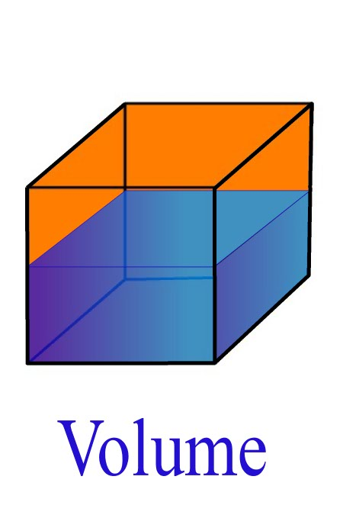
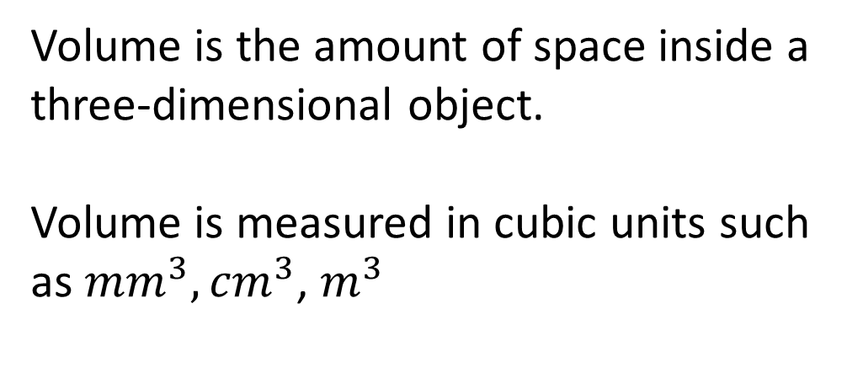
24
7
30
Volume of a Rectangular Prism
Date
EQ – How do we calculate the volume of a prism?
What is Volume?
Volume is the amount of space inside a three-dimensional object.
Volume is measured in cubic units such as ${mm}^{3},{cm}^{3}$, $m^{3}$

Slide 3
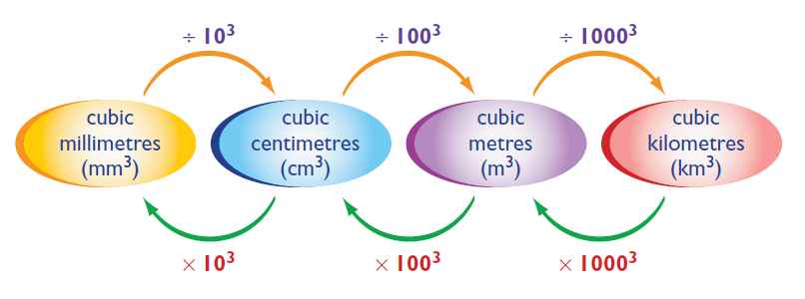
24
7
30
Volume of a Rectangular Prism
Date
EQ – How do we calculate the volume of a prism?
÷ 1,000 ÷ 1,000,000 ÷ 1,000,000,000
x 1,000 x 1,000,000 x 1,000,000,000

Slide 4
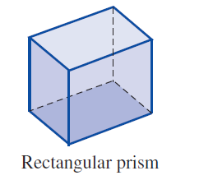
24
7
30
Volume of a Rectangular Prism
Date
EQ – How do we calculate the volume of a prism?
What is a Prism?
Prisms are solid shapes with identical opposite ends joined by straight edges.
They are three dimensional objects that can be cut into identical ‘slices’, called cross-sections.

Slide 5


Slide 6
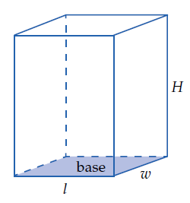
24
7
30
Volume of a Rectangular Prism
Date
EQ – How do we calculate the volume of a prism?
Rectangular Prims Formula
Volume = length x width x height
= L x W x H

Slide 7
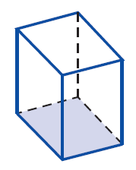
24
7
30
Volume of a Rectangular Prism
Date
EQ – How do we calculate the volume of a prism?
Rectangular Prims Formula
For solids with identical cross-sections
Volume = Area of Base x Height

Slide 8
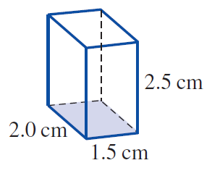
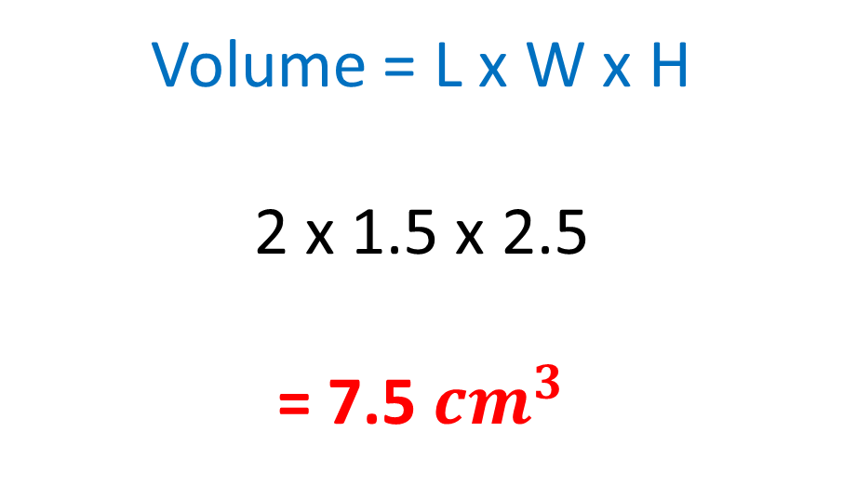
Practice
Volume = L x W x H
2 x 1.5 x 2.5
= 7.5 ${cm}^{3}$

Slide 9
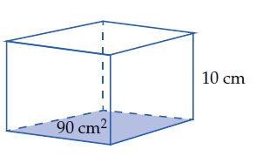
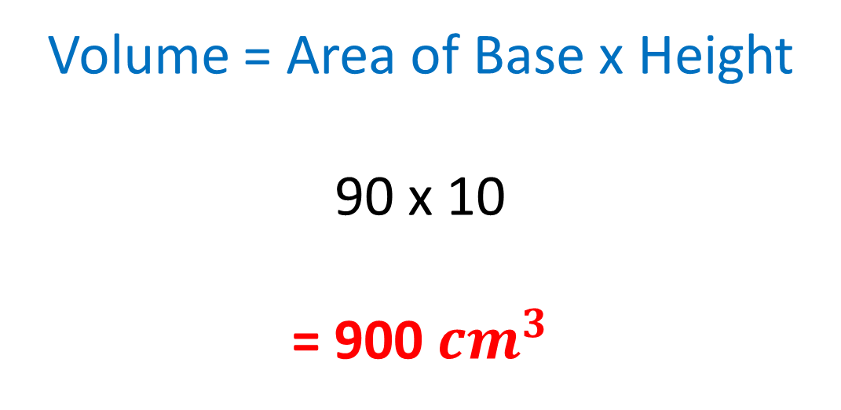
Practice
Volume = Area of Base x Height
90 x 10
= 900 ${cm}^{3}$

Slide 10
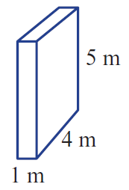
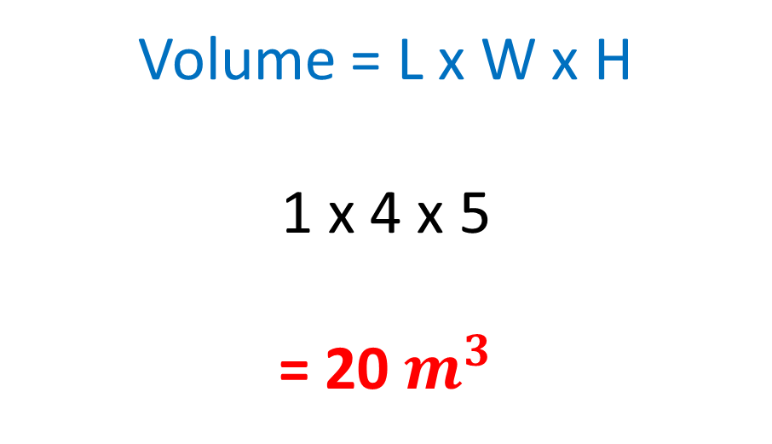
Practice
Volume = L x W x H
1 x 4 x 5
= 20 $m^{3}$

Slide 11
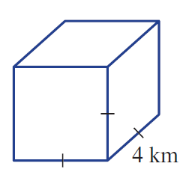
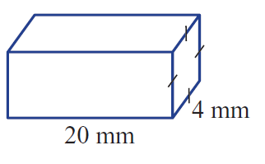
Your Turn
Find the Volume

Slide 12
Task
Worksheet - Freefall

